Slide 1
CCDR: Kyrgyz republic

Slide 2
Country overview
29-10-2024

Slide 3
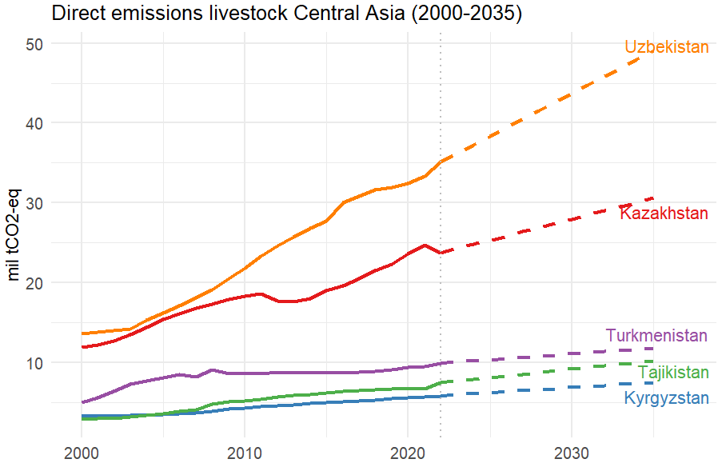
Kyrgyzstan compared to other CA countries
Table: Share of livestock emissions 2022
 | Direct livestock emissions (mil tCO2) * | Total Ag emissions (mil/t CO2) ** | % livestock of total Ag emissions | % Ag of domestic GHG emissions ** | % livestock of domestic GHG emissions
Central Asia | 79.8 | 92.4 | 86.40%
Uzbekistan | 33.3 | 38.8 | 85.90% | 20.10% | 17.30%
Kazakhstan | 24.8 | 29 | 85.30% | 9.00% | 7.70%
Turkmenistan | 9.4 | 12 | 78.90% | 6.40% | 5.00%
Tajikistan | 6.6 | 6.9 | 95.80% | 38.70% | 37.10%
Kyrgyzstan | 5.6 | 5.7 | 98.70% | 32.90% | 32.50%
* (https://www.fao.org/faostat (emissions include: enteric fermentation, manure management, manure left on pasture, manure applied to soils)
** (www.climatewatchdata.org)

Slide 4
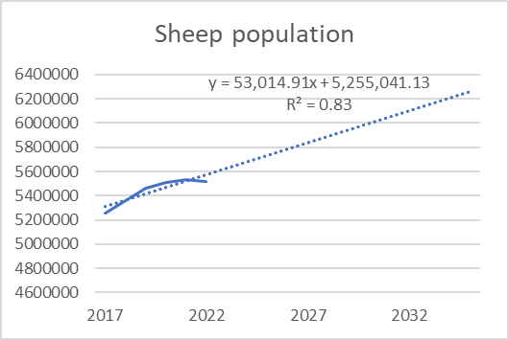
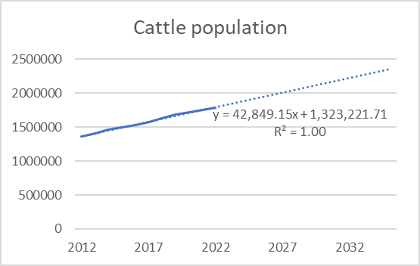
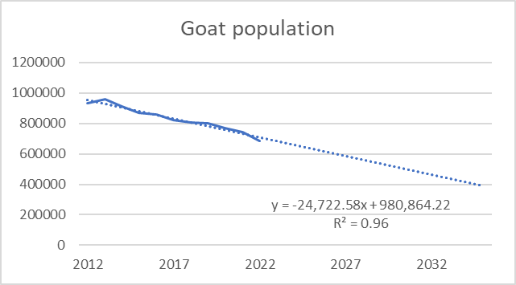
* (https://www.fao.org/faostat (emissions include: enteric fermentation, manure management, manure left on pasture, manure applied to soils)

Slide 6
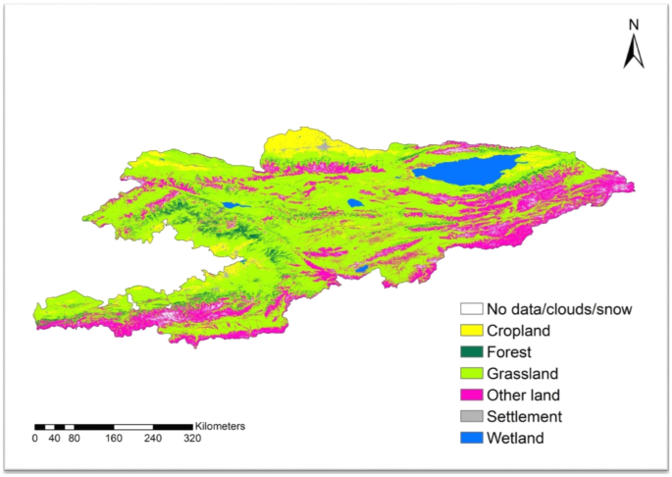
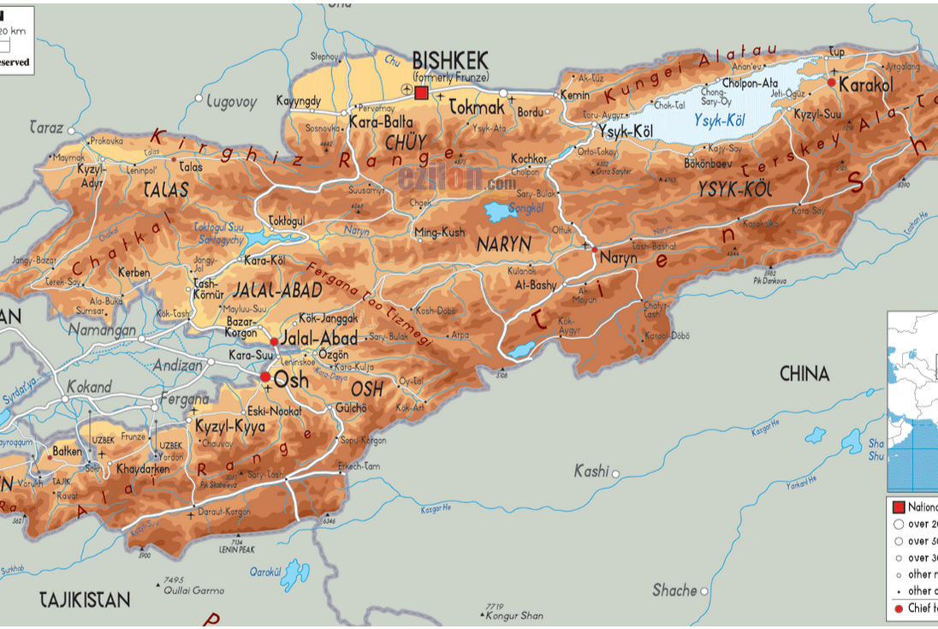
Country profile
More than three-quarters of the territory is covered by mountains.
Bassullu, C., & Martín-Ortega, P. (2023)

Slide 7
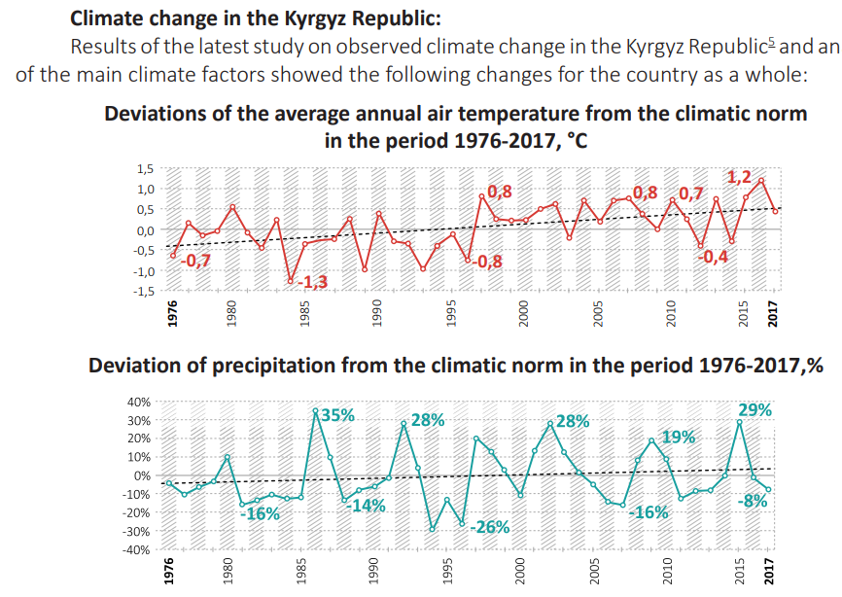
Effect climate
In increase in the annual air temperature in the range of 1.5 to 1.9°C, with the largest increase in temperature in the summer - in the range of 1.7 to 2.2°C; the preservation of interannual variability of precipitation with a slight tendency to increase in all seasons of the year; and an increase in the annual amount of precipitation in the range from 5 to 6 %, with the largest increase in winter from 9 to 13 %; and in summer a slight increase in precipitation in the range of 2 to 3%. (NDC)

Slide 8
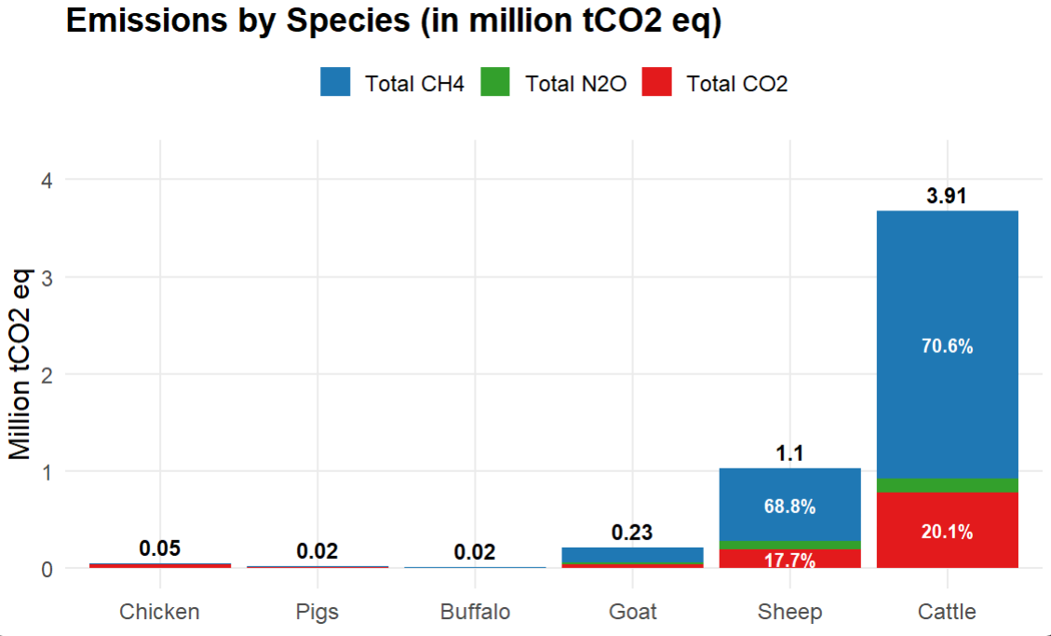

Slide 9
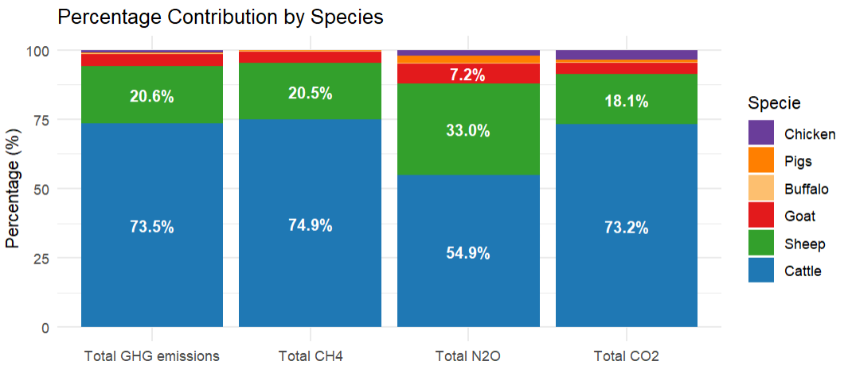

Slide 10
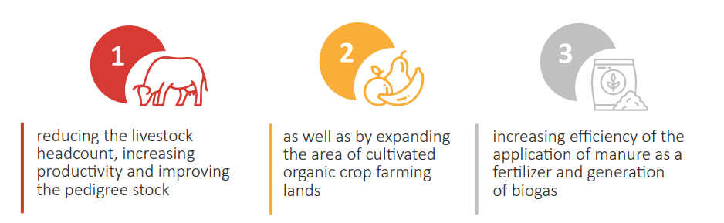
NDC
unconditionally reduce GHG emissions by 16.63% by 2025 and by 15.97% by 2030, under the business-as-usual scenario. Should international support be provided, GHG emissions will be reduced by 2025 by 36.61% and by 2030 by 43.62%, under the business-as-usual scenario.
1.2. Increase in the productivity of the breed herd for a gradual reduction in livestock (WM)
1.3. Improvement of manure utilization (WAM)
3.1. Development of biogas plants on large livestock complexes and farms (WAM)

Slide 11
Mitigation options Kyrgyz
Improve pasture
Regulatory changes pasture usage
Zero grazing
Usage unused pasture (improved infrastructure)
Reduction herd size
Improve health herd (vaccination, increase knowledge, optimal calving and lambing)
improving pedigree stocks
The regulation (reduction and control) of the number of animals (if livestock should not exceed the capacity of pastures and the quantity of winter feedstuff needed to meet the local ecological balance.)
Culling uproductive animals
Better feed especially winter (purchase of fodder, including from neighboring countries)
Improvements in manure
More use on land
Biogas increase
Move to bigger farms
Methane additives on bigger farms

Slide 12
Sources mitigation options:
https://www.landuse-ca.org/wp-content/uploads/2023/08/livestock-kyrgyzstan-report_compressed-compressed.pdf
MUNAVAR, Z. (2011). A study on livestock and land management in Kyrgyzstan.
Nefedjev, I., & Bolotbekova, A. (2016). Development Issues in the Traditional Livestock Sector of the Kyrgyz Republic.

